Slide 1

Copyright
Support for the Classroom
New Faculty Orientation 2018
Notes:
2 min: Danielle, introductions and overview of session
Intro:
Hello, and welcome to the Library & Copyright Support for the Classroom session! My name is Dani Collins and I’m the Supervisor of Editing and Copyright at Open Learning. The TRU Copyright office oversees and documents the use of 3rd party materials in all Open Learning courses and all campus course packs that are printed through our Printshop. We are also available to Faculty to answer any questions related to additional 3rd party materials that may be used in the campus courses outside of the course pack. It’s an exciting time in education right now with all the new technology and digitization of resources, but it can be a bit overwhelming to say the least. As Faculty at TRU, we know that you want to keep your courses current and engaging for students, but often with time constraints and multiple obligations. It can be very daunting to try to find available resources in a short amount of time, and to know how and when to use those resources responsibly, without infringing copyright, in print and within a learning management system or digital environment, such as Moodle.
Here to help you navigate the waters, to find those resources and use them responsibly, is Elizabeth Rennie and Jessica Fisher.
Elizabeth Rennie is our Instruction & Research Services Librarian. Elizabeth is going to introduce you to what resources are available to you, and your students, via our TRU library, including our spectacular Liaison Librarians, Spaces, Services, and resources.
Jessica Fisher is a TRU alumni and practicing lawyer at MJB Law. Jessica is the lead on the Copyright Awareness & Responsibility Initiative (“CARI”) and as such, she’s been presenting to several of the Faculty members already about Copyright matters and what copyright means to you as a Faculty member. She will continue to present to the Faculties throughout the Fall and Winter terms. After the presentation, we will be around to answer any further questions you may have about resources and copyright.
So, without further ado, here Elizabeth to get you started….

Slide 2
COPYRIGHT©TRU
Getting Clearance
COPYRIGHT
Created by Patrice Hall, Thompson Rivers University
Notes:
This presentation is intended to give new faculty members a brief overview of how to get clearance to use 3rd party works in the classroom. We will briefly discuss rights and responsibilities, fair dealing and educational exceptions and how TRU’s Copyright Office can help you navigate copyright issues in your work, your writing and your research activities.

Slide 3
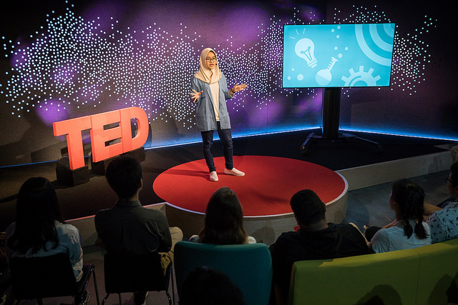
COPYRIGHT©TRU
TRU and its faculty, staff and students are creators and consumers of various forms of intellectual property.
Copyright is an intellectual property right that is very important to TRU faculty, staff and students.
COPYRIGHT
Ryan Lash/TED Darlene Gitta Hamida speaks at TED-Ed Weekend - June 17, 2017, TED HQ, New York, NY. CC BY-NC 2.0
Notes:
As creators, we rely on the protections offered by intellectual property laws to ensure that our work is protected from improper use.
As consumers of intellectual property, we are legally (and morally) obligated to respect the intellectual property rights of others.

Slide 4
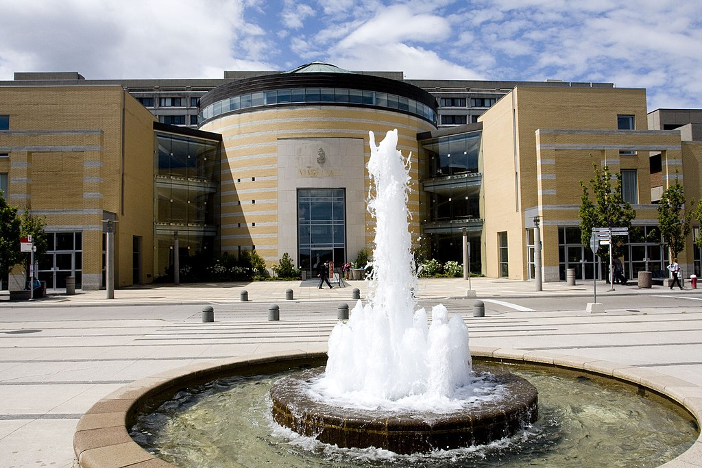

Copyright Infringement
Infringing copyright is a serious matter and TRU requires each of its faculty, staff and students to comply with the Copyright Act of Canada.
The Intellectual Property Office at TRU can provide you with information regarding copyright to help you understand what you can and cannot do with copyrighted works.
^{For a brief} summary of copyright law, visit https://www.tru.ca/ipo/basics.html
COPYRIGHT
By Andrei Sedoff [CC BY 3.0], via Wikimedia Commons
By SVG erstellt mit Inkscape (yorku.ca) [Public domain], via Wikimedia Commons
Notes:
Failure to comply with copyright law may result in TRU being sued for infringement and found liable for copyright fees and damages. A recent high profile copyright case involving a Canadian University is Access Copyright v. York University. The suit involved copying of 3rd party content for course packs and initially named 5 faculty members. In the process, Moodle log and backup files of content posted by all York faculty over the previous 3 years was subpoenaed and examined so that other alleged infringing activity on the part of York faculty was exposed to scrutiny. The suit has cost York hundreds of thousands of dollars in its legal defense alone over the 4 year period from when the lawsuit was brought in 2013 to the Federal Court decision in 2017. It was a stunning loss for York on virtually all points of the case. The 5 faculty members named in the suit were not excused by the judge. York is currently in the appeal process, so the financial bleeding continues. Institutions can be held accountable for copyright infringement, but faculty, staff and students may also be personally liable and responsible for payment of fees and damages.

Slide 5
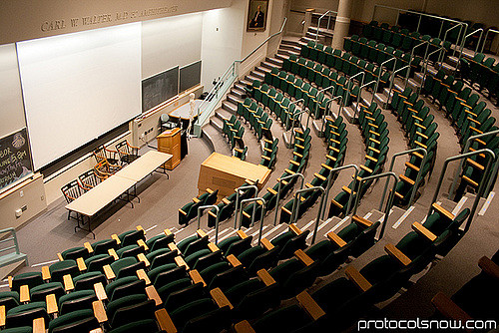
When does copyright law apply at TRU?
Face-to-face classroom
Online classroom
Developing course material
Print or electronic course packs and courseware
Writing and research
Student work
COPYRIGHT
Protocol Snow. Harvard Medical School Classroom. CC BY-NC-ND 2.0 via Flickr
Notes:
We need to be compliant with regards to Canadian Copyright Law in curriculum development and teaching as well as academic writing and research activities. So – now that we know that copyright is an important issue with wide application at TRU – let’s cover the basics of how it works and how you get clearance to use other people’s work, or 3rd party content.

Slide 6
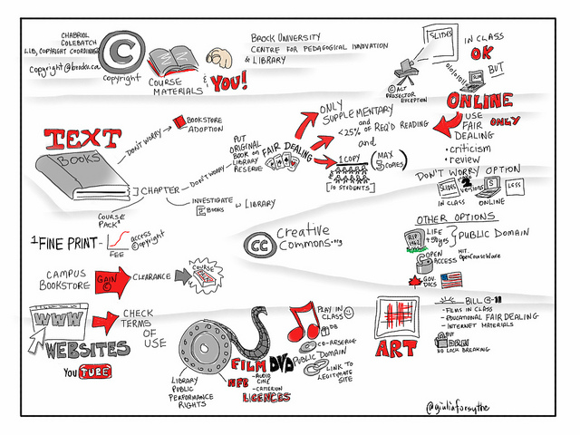
How does copyright work?
Copyright law protects all original works such as books, sound or video recordings, dramatic, musical and artistic works, photographs and other printed or digital material.
Under Canadian copyright law, the copyright owner of a work has the sole right to produce, reproduce, perform, publish, adapt, translate and telecommunicate that work
COPYRIGHT
Giuilia Forsythe. Copyright. Course Materials and YOU! CC0 1.0 Public domain via Flickr
Notes:
A. Works that you may commonly use in education include textbook excerpts, films, documentaries, YouTube videos, TED talks, transcripts, plays, journal articles, digital images, music, computer programs, translations or compilations and collective works. Copyright attaches when a work is at least minimally creative and fixed.
B. Which means that people who want to use the work in some way may need to get permission first.

Slide 7
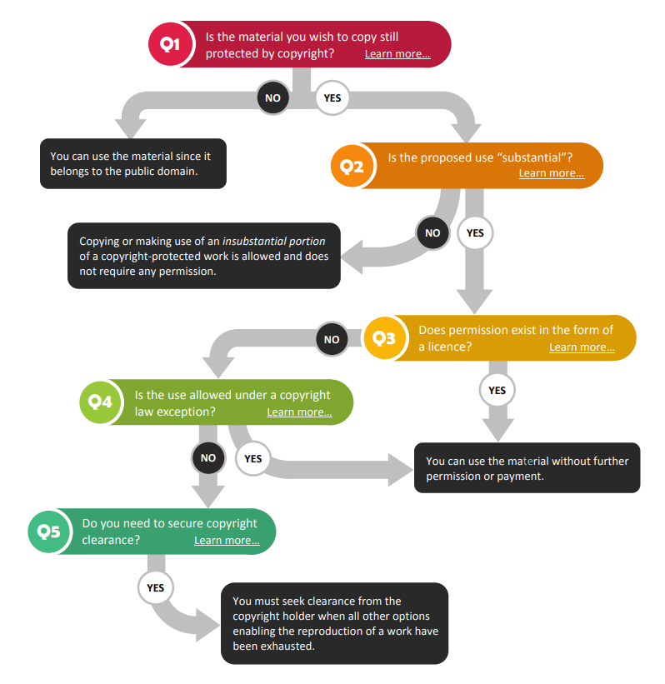
Permission to Copy
There are several steps involved in determining permission to copy specific works. Here are the first four steps:
Is the work protected by copyright?
Are you copying a substantial portion of the work?
Does permission exist in the form of a license?
Is copying of the work permitted under the Copyright Act under an education exception or fair dealing?
COPYRIGHT
University of Ottawa Copyright Office. Quick reference guide to copyright [Graphic]. Content adapted from the University of Toronto’s Copyright Roadmap and the University of Western Ontario’s Copyright Decision Map, with permission.
Notes:
1. Is the work protected by copyright? Works that are in the public domain are not protected by copyright. Works fall into public domain either by gift of the creator/author or by expiration of copyright – in Canada that is life of the author plus 50 years, with some exceptions.
2. Are you copying a substantial portion of the work? The Federal Court of Appeal supports a bright-line rule that copying less than 2.5% of a work is insubstantial use, which doesn’t trigger copyright.
3. Does permission exist in the form of a license? The University library has negotiated digital licenses for e-resources with varying permissible use licenses. Many of these online articles are licensed for use in classrooms and learning management systems. Additionally, many works are published with a Creative Commons license or site license which provides open access and permission to copy and distribute.
4. Is copying of the work permitted under the Copyright Act under an education exception or fair dealing? Copying is permitted for certain uses, including education, research and personal study if it meets the related requirements.

Slide 8
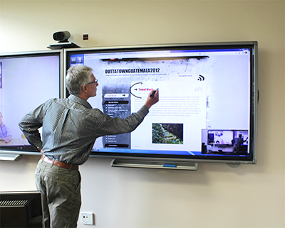
Education Exceptions
In addition to the fair dealing exception, the Copyright Act provides the following additional exceptions to infringement of copyright:
Section 29.4 (1)- Exception for Displaying Work
29.5 Performances
Section 30.01 - Exception for a Lesson
Section 30.04(1) – Works Available Through the Internet
COPYRIGHT
Inland. University classroom with interactive monitors. http://www.inlandav.ca/sales/interactive.php
Notes:
The Copyright Act gives us several education exceptions – these are a few:
29.4 Reproduction for instruction in order to display the work,
29.5 Performances which permits showing films in a classroom,
30.01 Exception for a lesson provides technological neutrality so that a student taking a course online is deemed to be on the premises of the educational institution, the same as face to face instruction.
30.04 “The Internet Exception” which permits the reproduction and use of works found on the internet.
There are qualifications to most exceptions, and additional restrictions may apply in some circumstances, for example:
29.4 Display requires that the work not be readily and reasonably available for sale in the format you require.
29.5 Performances requires that films you show your students be from a legal source.
30.04 requires that internet sources not have TPMs like paywalls or passwords protecting their content, or clearly visible notices that specifically restrict educational use.
For further guidance on using exceptions, please refer to TRU’s copyright website or contact us for further information.

Slide 9

29.21 Non-Commercial User-Generated Content
COPYRIGHT
Sean MacEntee. Youtube. CC BY 2.0 via Flickr
Notes:
This is a relatively new exception, informally known as the “YouTube exemption” which permits an individual to use existing works in order to create a new work and then publish it on a free platform like YouTube or Vimeo. So, you could ask your students to create a video for an assignment, and they could incorporate copyright-protected works in their new creation, such as background music and images. The non-commercial requirement says that the use of the new work must not have an adverse effect (financial or otherwise) on the original work, and the source should be cited if it is reasonable to do so.

Slide 10
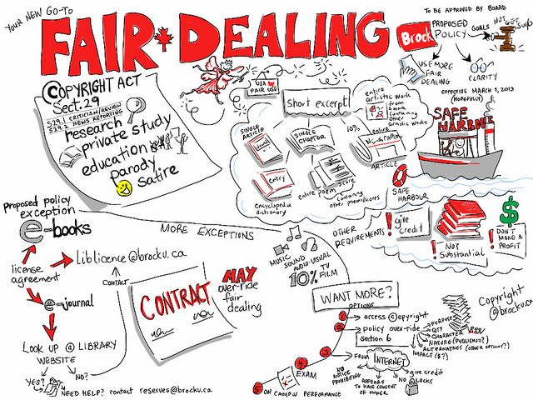
Two-Part Test for Fair Dealing:
Step 1: The dealing must be for one of the eight allowable purposes: research, private study, education, parody, satire, criticism, review, or news reporting; and
Step 2: The dealing must be “fair”. The Copyright Act does not provide a definition of “fair” and will depend on the facts of each case. The Supreme Court of Canada has set out a series of six factors to assess whether a dealing is fair.
COPYRIGHT
Giulia Forsythe. Fair dealing. CC BY-NC-SA 2.0 via Flickr.
Notes:
Fair dealing is an exception that we use commonly at TRU. Fair dealing is a user right that gives educators the ability to copy short excerpts of works for educational purpose on behalf of their students. This statutory exemption to copyright infringement is available if the “dealing” is for both an allowable purpose and “fair.”

Slide 11
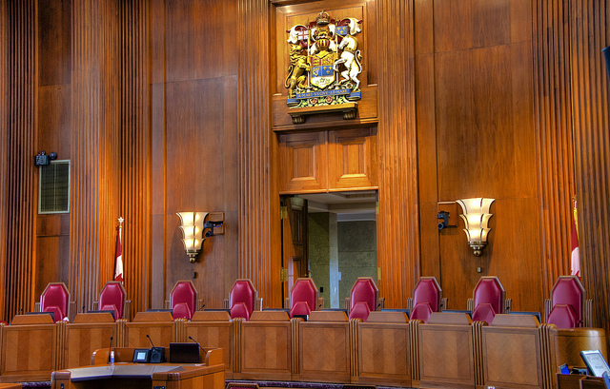
Fair Dealing
In CCH v. Law Society of Upper Canada, the Supreme Court of Canada identified six factors that determine fairness:
^{The purpose of the dealing}
^{The character of the dealing}
^{The amount of the dealing}
^{The nature of the work}
Available alternatives to the dealing
The effect of the dealing on the work
COPYRIGHT
Jamie McCaffrey The Nine. CC BY-NC 2.0
Notes:
In a court of law, it is up to the defendant to prove that his or her dealing with a particular work was fair. The Copyright Act does not lay out or define what is fair in a literal sense. Each case would be judged on its merit. The six factors identified in CCH (case law) are considered in a Canadian court of law.
Purpose: Is the use commercial? Commercial use would be less fair.
Character: Is the use new or transformative? Is the distribution wide?
Amount: How much of the original is being used? The larger the portion of the original copied, the less fair the use may be.
Nature: Was the work unpublished or confidential?
Alternatives: Could a different work have been used that is openly licensed or in the public domain?
Effect: Does your use economically impact the original – will the original not be purchased because of your copying?
The relevance of the factors depends on the context. Sometimes, certain factors will be much more significant than the others. Occasionally other factors, beyond these six, may be relevant. It is not necessarily the case that all six factors need to be satisfied.

Slide 12
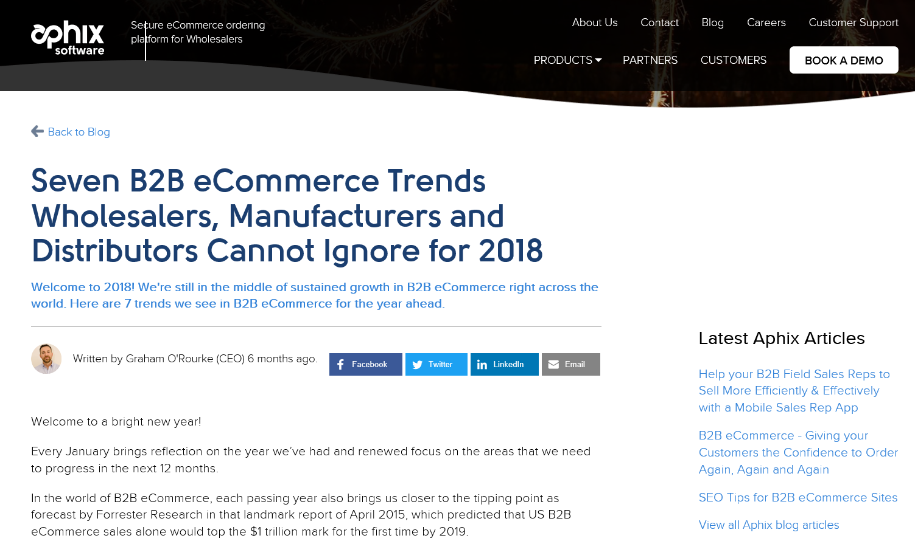
COPYRIGHT
Notes:
Here’s an example of how you might apply the six factor analysis fair dealing exception for education. Aphix Software sells an eCommerce ordering platform to wholesalers. They have a collection of timely and informative web articles on their site. A google search for articles on eCommerce trends turns up this web article. Weblinks disappear, and you want to preserve a copy of the article for your marketing class by placing a pdf or html copy on Moodle. Can you do this, without asking permission of Aphix?
The purpose of the dealing – You want to use this e-commerce trade publication web article for a marketing course – educational purpose
The character of the dealing – Distribution is to students enrolled in the course, content accessed on a password-protected learning management system
The amount of the dealing – You are taking one article from an online source of over 50 articles
The nature of the work – The work has been published widely and freely on the open internet
Available alternatives to the dealing – You haven’t found a good substitute that is already licensed for use
The effect of the dealing on the work – There is no significant impact on Aphix’s ability to sell their ordering platform to Wholesalers. In fact, you just may have given them some free visibility they’d otherwise not have enjoyed.
Note that Educational Exception 30.04 (The Internet Exception) might also apply – often more than one exception provides you with clearance to use 3rd party works.

Slide 13
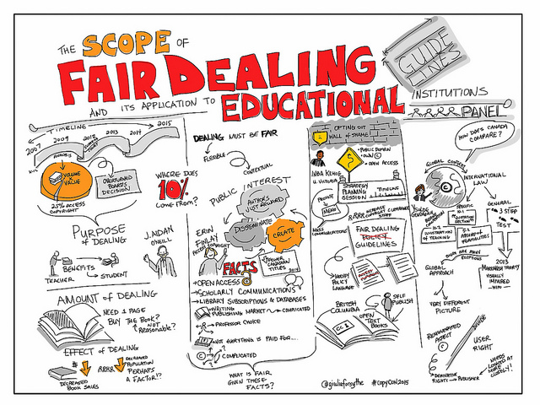
TRU Fair Dealing Policy
Short excerpt is defined as follows:
Up to 10% of a “work” or one chapter (whichever is greater)
One article from a periodical
A single newspaper article
An entire entry from an encyclopedia, annotated bibliography, dictionary or similar reference work.
An entire artistic work from a copyright – protected work containing other artistic works
An entire single poem or musical score from a copyright – protected work containing other poems or musical scores
COPYRIGHT
Giulia Forsythe. The scope of fair dealing and its application to educational institutions. CC0 1.0 Public domain via Flickr.
Notes:
TRU’s Fair Dealing Policy is based on guidance from Universities Canada. Its authority is not the Copyright Act, as the Act is silent on any definition of a short excerpt. The policy permits faculty members, instructors and staff members to copy and communicate, in paper or electronic form, short excerpts from copyright-protected works for any of the eight fair dealing purposes – typically for education or research purpose.
These amounts are considered “safe harbour” by most Canadian post-secondary institutions.
Other use may fall under fair dealing if the six-factor analysis tends towards a “fairness” outcome. In some cases, an entire work such as a work of art, photograph or graphic, may be copied. If you’re unsure, contact the Copyright Office for assistance. TRU’s Fair Dealing Policy is available on our Copyright website.

Slide 14
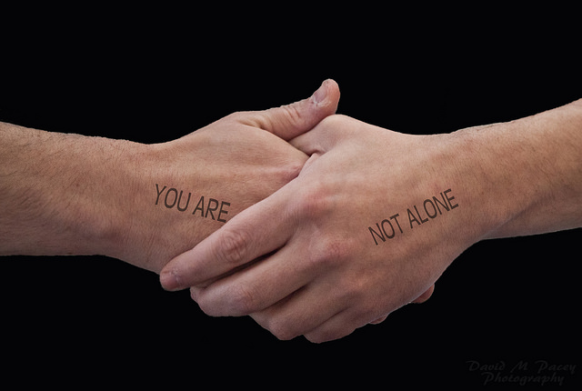
Obtaining Permissions and Licenses
Does your intended use of a copyright-protected work fall outside the terms of a license, fair dealing or another exception to copyright?
- You’ll need documented permission, or a license, to use it.
COPYRIGHT
David Pacey. You are not alone. CC BY 2.0
Notes:
Remember that “use” refers to any of the bundle of rights held by the copyright owner – to copy, to distribute, to translate, to adapt or alter the work in any way. Only the copyright holder or their legal designee can grant a permissions license. Granting a license is the prerogative of the copyright holder – they are under no obligation to grant you any rights. In practice, permissions licenses can be usually be obtained, often for a fee, for a reasonable portion of the work. Copyright clearance is typically granted for a specific time period – most often, for the duration of the semester and exam period. Paid licenses usually require re-licensing of the content for use in subsequent semesters.

Slide 15
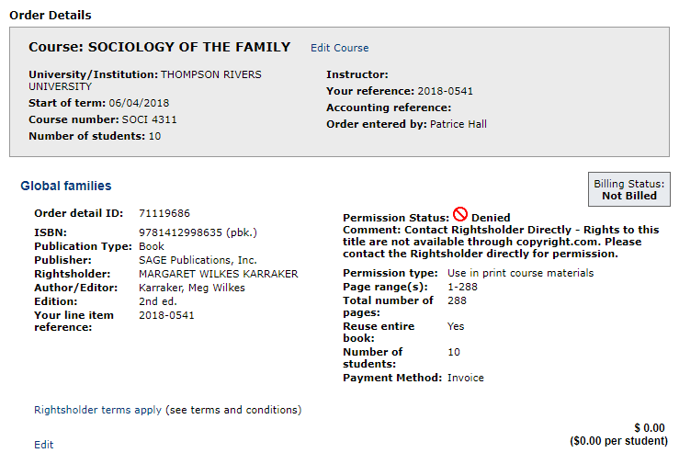
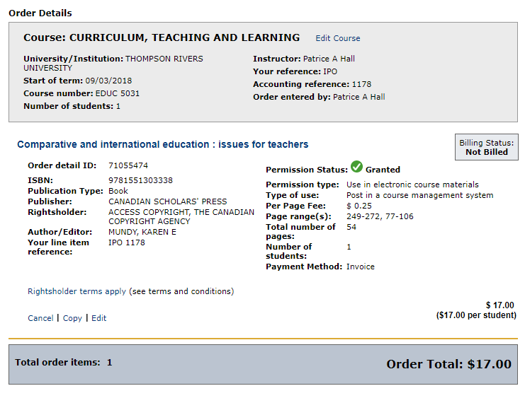
Permission can be granted or denied by the rightsholder
Notes:
When you request a permissions license, the publisher or rightsholder can deny your request, grant your request, or simply ignore your request. Sometimes a permissions grant requires payment, and sometimes permission is granted for free.

Slide 16

Indigenous Works
Ask permission/consent of:
The creator of the work
Band or Tribal Council
Other Indigenous governing body
COPYRIGHT
Rick Kennedy. First American Dream. CC BY 2.0
Notes:
If you wish to use a work of Indigenous origin that the creator has not published under a Creative Commons license, please ask permission rather than using statutory fair dealing or education exceptions. Dr. Greg Younging, UBC professor and expert in intellectual property matters related to First Nations works, advises that Indigenous Protocols apply even when non-Indigenous laws do not require permissions. Always request permission from the creator of the work, or of the appropriate Band or Tribal Council or other Indigenous Governing Body responsible for the work. Dr. Younging advises “Where culturally sensitive indigenous materials are in question, you should make every effort to consult an authoritative member of the particular Indigenous People for confirmation.”

Slide 17
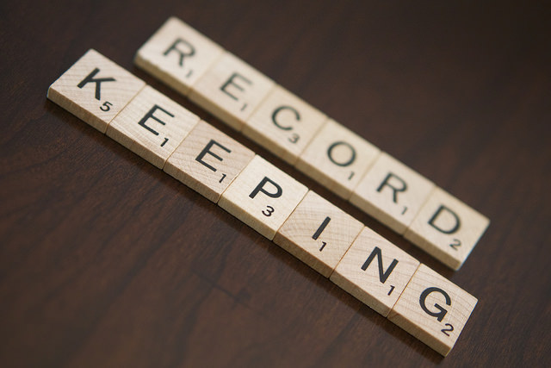
To protect yourself and the University
Record your use of third party materials and your justification for using (license, fair dealing, public domain, open source, other educational exemption) or have the Copyright Office do this for you
Get a license if you are using more than a short excerpt of unlicensed copyright protected content and your use is not covered by an education exception.
Cite/credit where possible, understanding that acknowledgement is not a substitute for copyright clearance
If you are in doubt, ask permission of copyright owner or ask the Copyright Office to help
COPYRIGHT
“Record Keeping" by Nichole Burrows is licensed under CC BY-NC 2.0
Notes:
Document! Verbal permission does not protect you or the university from infringement – you must have permission from the copyright holder in writing – email from the rightsholder is fine, but an informal phone call or conversation with someone at an agency isn’t sufficient.

Slide 18
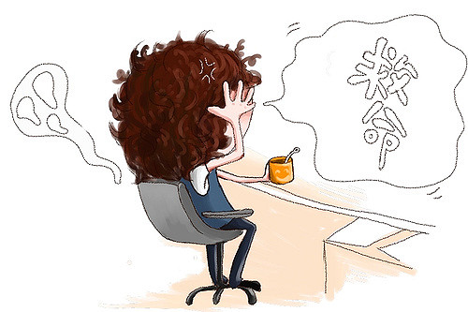
How can we help you?
Determining if a work is copyright protected
Verifying if TRU holds a license providing permission to copy/distribute a work that is copyright protected
Assessing whether a particular use of a work falls under one of the Canadian Copyright Act exemptions
Providing copyright clearance for the use of works not under license to TRU
Helping faculty understand their rights and responsibilities under “Fair Dealing” as it applies to the use of copyright-protected works
Clearing works to be posted on Moodle/Blackboard
Licensing works to be included in print or e-course packs
Assisting with copyright issues in Open Educational Resources (OERs)
COPYRIGHT
Lazydoll. Help! CC BY-NC 2.0
Notes:
TRU Intellectual Property Office can help you ensure that you remain copyright-compliant by:

Slide 19
FAQs
May I post examples of my students’ work on Moodle ?
Can I copy, post or distribute government reports and documents?
Can I play music and videos in class?
Can I use third party materials like photos, artwork, charts, graphs and maps in my lessons?
Are there any databases of copyright materials that I can use for free without worrying about copyright?
Is it okay to use images or other material from the Internet for educational purposes?
How does copyright work for Open Education Resources (OERs)?
Do I need permission to link to a document I find on the internet?
COPYRIGHT
Notes:
1. Only if you have the student’s permission. Students own the copyright in the works they create. The University does get the right to make copies of the work for academic purposes, but this right does not extend to making it available online. Accordingly, you should ask students in advance whether they consent to having their work posted online and keep written records of the permissions given
2. It depends. More recently, Federal government documents made available on the internet are generally published under an Open Government License, giving permission to reproduce for non-commercial purpose, with certain requirements. Always cite according to the instructions, and ensure you are using the current version of the document. BC Provincial Government documents are copyright protected by the Queen’s Printer, and permission must be requested prior to copying and distributing. Documents and reports produced by other levels of government, agencies, health authorities, consulting companies and such will require a permissions license unless otherwise granted.
3. Yes! The Copyright Act allows you to play a sound recording or live radio broadcasts in class as long as it is for educational purposes, not for profit, on University premises, before an audience consisting primarily of students. However, if you want to use music for non-educational purposes, for example, for background music at a conference or community event, a license must be obtained from the copyright collectives the Society of Composers, Authors and Music Publishers of Canada (SOCAN) and Re:Sound
You may play videos in class in the following circumstances:
You may show a film or other cinematographic work in the classroom as long as the work is not an infringing copy, the film or work was legally obtained, and you do not circumvent a digital lock to access the film or work.
If you want to show a television news program in the classroom, under the Copyright Act, educational institutions (or those acting under their authority) may copy television news programs or news commentaries and play them in class. This provision doesn’t extend to copying documentaries, movies, TV series or other content off cable TV for showing at a later time.
4. Yes, with certain restrictions. You can copy an entire artistic work from a copyright-protected work containing other artistic works. You can make a copy of a work in order to display it in a lesson (provided it’s not available for purchase in the format you need). For example, you could display a stand-alone map in a lesson, but you would need permission to copy and distribute it. If you’ve adopted a textbook, your agreement with the publisher may allow you to use substantial material from the text, teacher materials and related third party materials in your lectures, lessons, exams, handouts and assignments.
5. Yes. There's a wealth of material out there which is either in the public domain or available under Creative Commons licensing, which generally means the work is available for free, subject to certain limited conditions, such as acknowledgment of the author. One of the best sources I’ve seen for openly licensed content is found in BCCampus’ Self Publishing Guide which provides 10 pages of links to openly licensed content. https://opentextbc.ca/selfpublishguide/chapter/resources-search-find/.
For other online materials, a recommended best practice is to check the website's Terms of Use", or "Legal Notices" section to confirm what conditions apply to use of the website's material. In many cases, you may be able to use the material free for non-commercial and educational purposes.
6. Materials on the Internet are treated the same under copyright law as any other copyright materials, so if you want to use them, they either have to fall within one of the Copyright Act's exceptions (such as fair dealing or the educational use of the Internet exception), or be open access or in the public domain. If what you want to use isn't from an open access or public domain source and does not fall into one of the Act's exceptions you will have to obtain permission from the copyright owner. Note: the person who posted the material may not be the copyright owner and may not have the right to grant you permission to use the material. If this is the case, you should not use the material unless you can identify and obtain the copyright owner's permission.
If your use exceeds fair dealing limits, check the website's "Terms of Use", "Legal Notices" or similar section. Exemption 30.04 (Internet Exemption) may apply if there are no terms or notices that specifically exclude educational use. Note that you may not use content that is protected by DRM (digital rights management) or TPMs (technological protection measures) such as account/passwords and paywalls.
7. The criteria for inclusion in the BC Open Textbook Collection require that you release your work under an open-copyright license or in the public domain. Any 3rd party content used in the textbook must be similarly licensed. This permits downstream copying, distribution, modification, remixing and adaptation – even for commercial purposes, depending on the license applied. Note that fair dealing doesn’t apply to the BCcampus Open Textbook program, and permissioned 3rd party content isn’t acceptable.
If you are creating or adapting OER for campus use only, it’s the same as for submission to BCcampus repositories, except you may also include 3rd party content for which you’ve received permission. You choose your license, depending on the rights you want to give to others. 3rd party content such as text, images, tables, charts, graphs and other media must be either be reproduced with permission, covered by a CC license or in the public domain. 3rd party inclusions in your work must be clearly attributed where they occur, along with their licensing info.
8. No – giving your students a URL for an internet resource doesn’t trigger copyright, as you aren’t copying anything. With regards to library e-resources – providing your students with a proxied stable link is the best way to ensure access to the most recent version of an article. Linking to the article also allows the library to track use of a particular e-resource.

