Slide 1
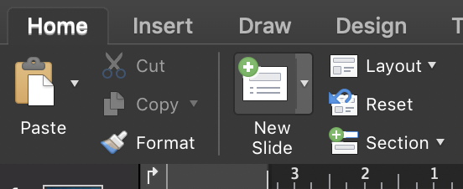
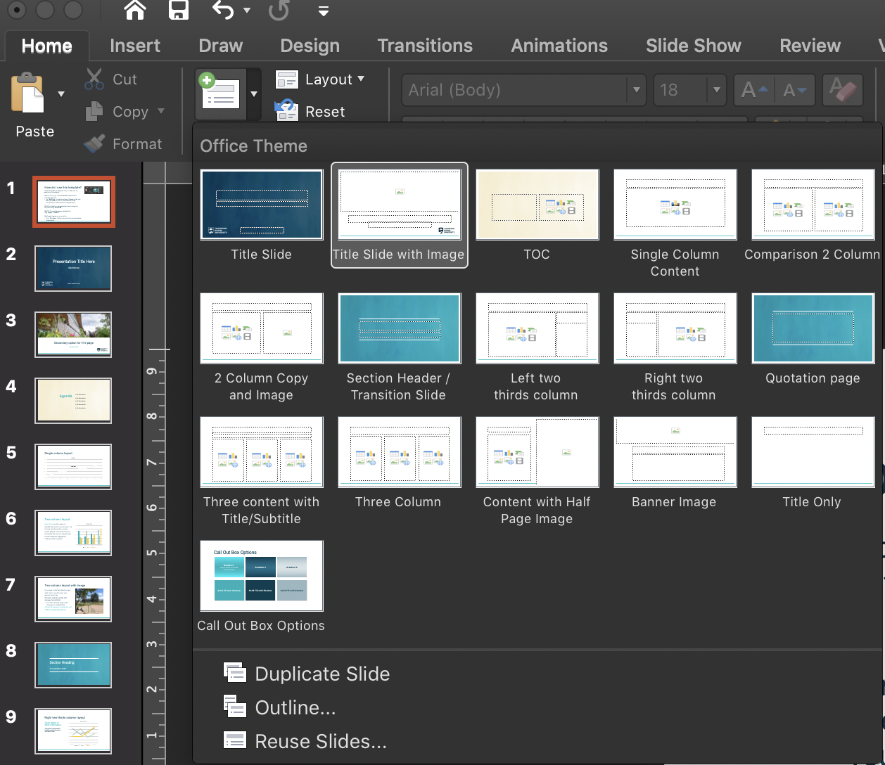
How do I use this template?
The following slides are samples. They include notes on ways to use this template.
Have a look through—then delete these sample slides and create your own:
Use New Slide and choose a layout. Choose a slide type. You might need a Title Slide, a Half and Half Slide, or a Left Two Thirds Column Slide. Help yourself!
NOTE: Don’t apply a new layout style to an existing slide. Start fresh using New Slide.
PRO TIP: Change the layout on a blank slide using Layout if needed.
Don’t forget to save your presentation.
Go to File: Save. That will save your file as a presentation, not a template.

Slide 2
Presentation Title Here
Sub title here
Date, location here

Slide 3

Secondary option for Title page
Location | Date

Slide 6
Agenda
List item here
List item here
List item here
List item here
List item here

Slide 7
Single column layout

Slide 8
Two-column layout
Quick Tips: Use this space to highlight key points on your topic. Try to keep the information concise.
Charts default to the first colours in the palette but you can change them to add a different highlight by clicking inside the graph.

Slide 9

Two-column layout with image
If you type in this field titled you get Arial. This is used for lists and general body copy.
Hit return and tab and the text changes to Arial bold.
Hit return and tab again and it changes to a bulleted list
A fourth tab sequence is an italic serif
A fifth is a regular style serif

Slide 10
Section Heading
Or a transition slide

Slide 11
Right two-thirds column layout
Chart, tables or other information
This section could be used to highlight specific information on a chart or table.

Slide 12
Left two-thirds column layout
Use this space for a call-out. Any text that you want to amplify as important could go in a colored text block like this one.
If you want to create a block similar to this one see slide XX for alternate colour options.

Slide 13
“
Quotation here…..
”

Slide 14
Three-column layout with subhead
This slide is best used for key points or comparisons

Slide 15
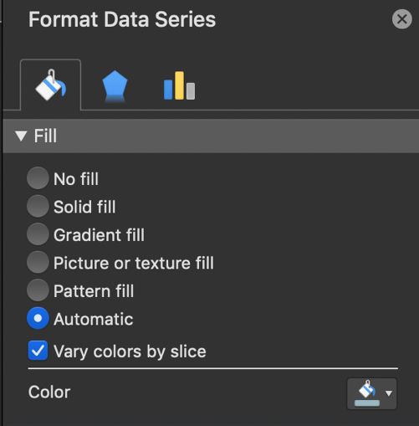
Three-column layout
This slide is best used for key points or comparisons. You can use charts, images or copy. If you want to change the style of chart (right click > change series chart type) or change highlight colours by clicking a section and choosing a new fill.
Fill colour

Slide 16

Half and half layout

Slide 17

Banner image with single column

Slide 18
Call Out Box Options
Gradient 1
Gradient 2
Gradient 3
Solid Fill with Shadow
Solid Fill with Shadow
Solid Fill with Shadow

